Slide 1
Level 4 Unit 8 - Vocabulary

Slide 2
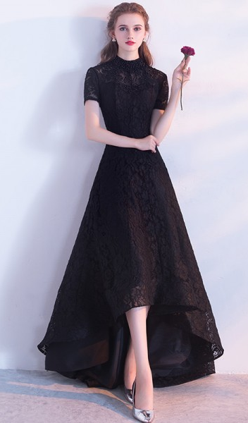
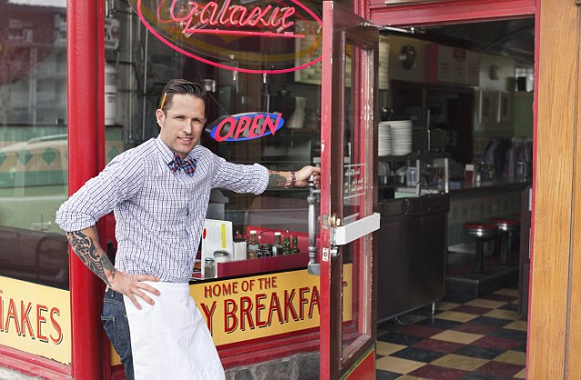
elegant
polite

Slide 3
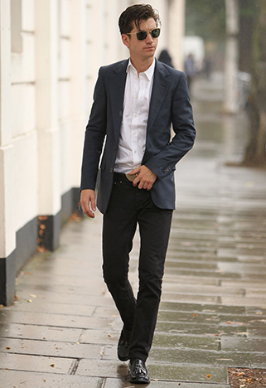
slim
artistic

Slide 4
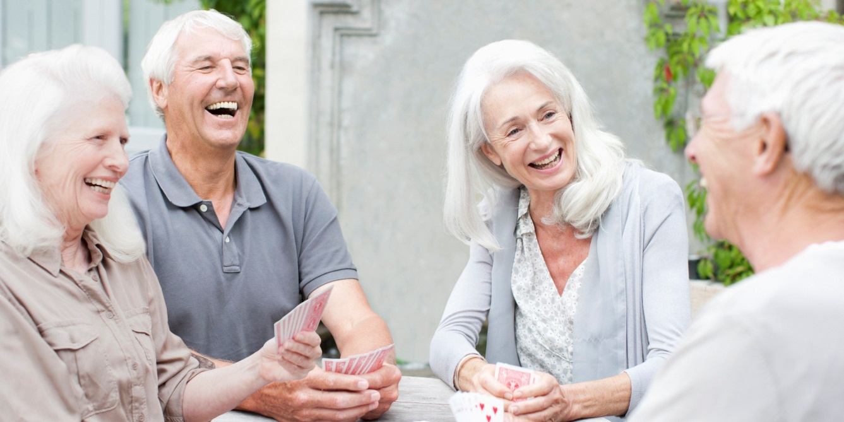
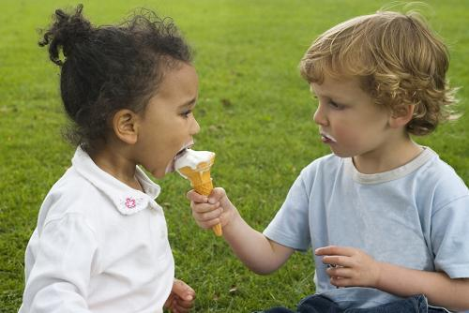
elderly
generous

Slide 5
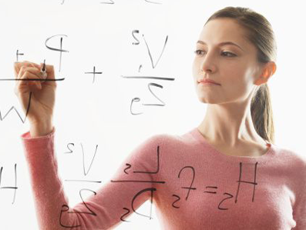
muscular
intelligent

Slide 6
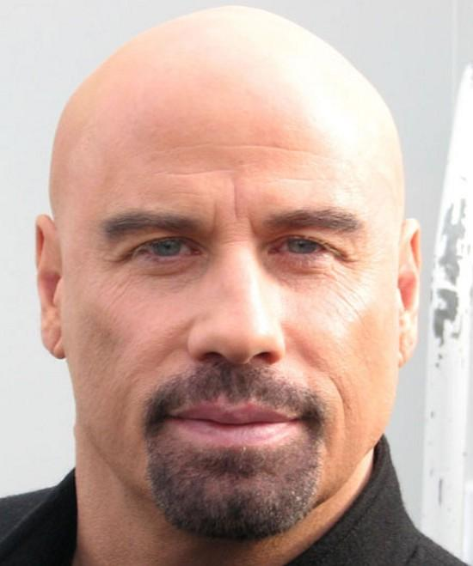
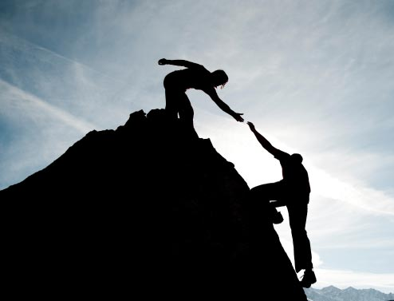
bald
reliable

Slide 7
3 Confusing Questions
1. What is he like?
2. What does he look like?
3. What does he like?

Slide 8
3 Confusing Questions
1. What is he like?
He is kind and generous.
(personality traits)

Slide 9
3 Confusing Questions
Question
What + BE + subject + like?
Answer
Subject + BE + personality trait.

Slide 10
3 Confusing Questions
2. What does he look like?
He is tall and handsome.
(physical traits)

Slide 11
3 Confusing Questions
Question
What + DO + subject + look like?
Answer
Subject + BE + physical trait.

Slide 12
3 Confusing Questions
3. What does he like?
He likes reading and hiking.
(enjoyment)

Slide 13
3 Confusing Questions
Question
What + DO + subject + like?
Answer
Subject + LIKE +
object/to + verb/verb + ing.

